Slide 1

Developing a ecurity Suite for Android-based Smartphones
Abd El-Rahman Mohamed

Slide 2

Overview
Why is a Security suite needed ON Android?
Aims & Objectives
Progress So Far
Next Steps
What is a Security Suite?

Slide 3
What is a Security Suite?
‘A collection of software utilities that protect a user’s device from malware.’ (PCMag, 2022)
Malware Scanner
Permission Manager
App Locker
File Locker

Slide 4

Why is a Security Suite needed on Android?
People are becoming more reliant on their smartphones
Smartphone manufacturers are inconsistent with their device security policy
Only 30% of devices are running Android 12 (Statcounter, 2022)
Would need multiple apps to cover every aspect of security on their Android devices
Mainstream companies, such as McAfee and Norton, require some form of payment

Slide 5

Aims & Objectives of the Project
Package multiple existing Android security module implementations into one security suite.
Conveniently shows the user an overview of their current on-device level of security
Requires no prior modification to the OS of the device
Is compatible with older versions of Android (Android 5.0)

Slide 6
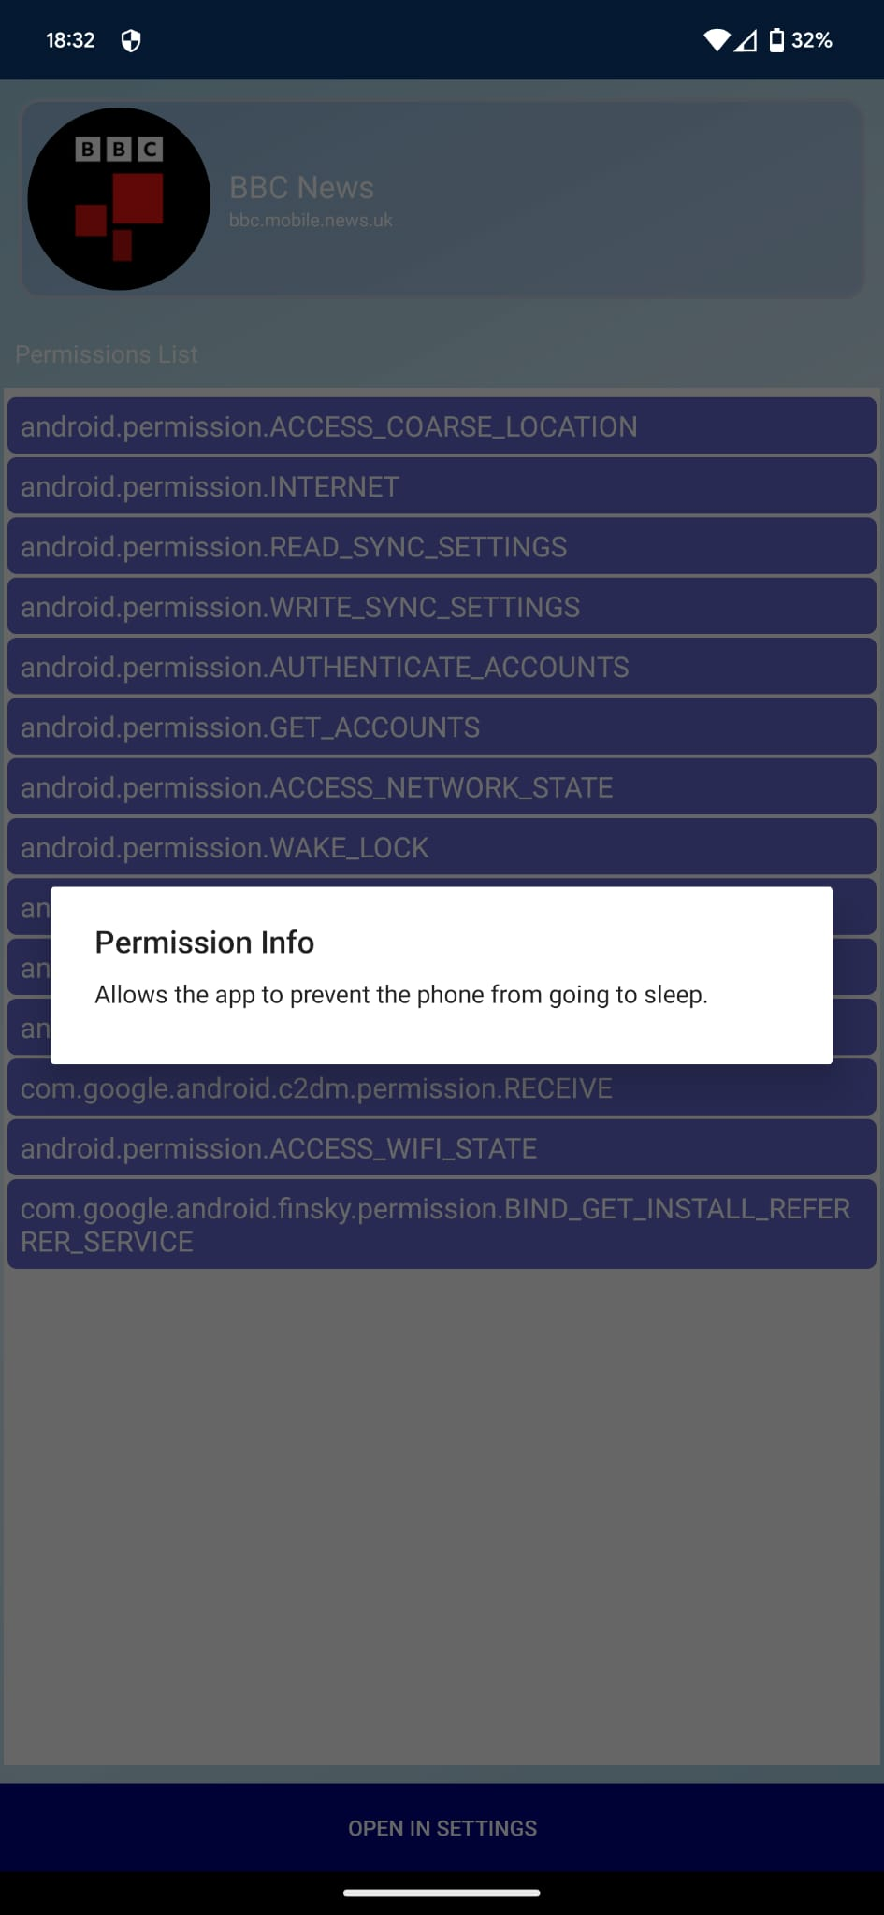
Progress so Far
Malware Scanner
Used open-source implementation of:
File-Based Malware Scanner (Hypatia)
App-Based Malware Scanner (LibreAV)
Permission Manager
Created my own implementation of a permission manager

Slide 7
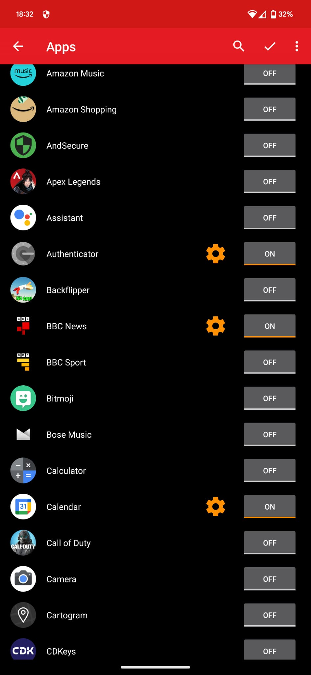
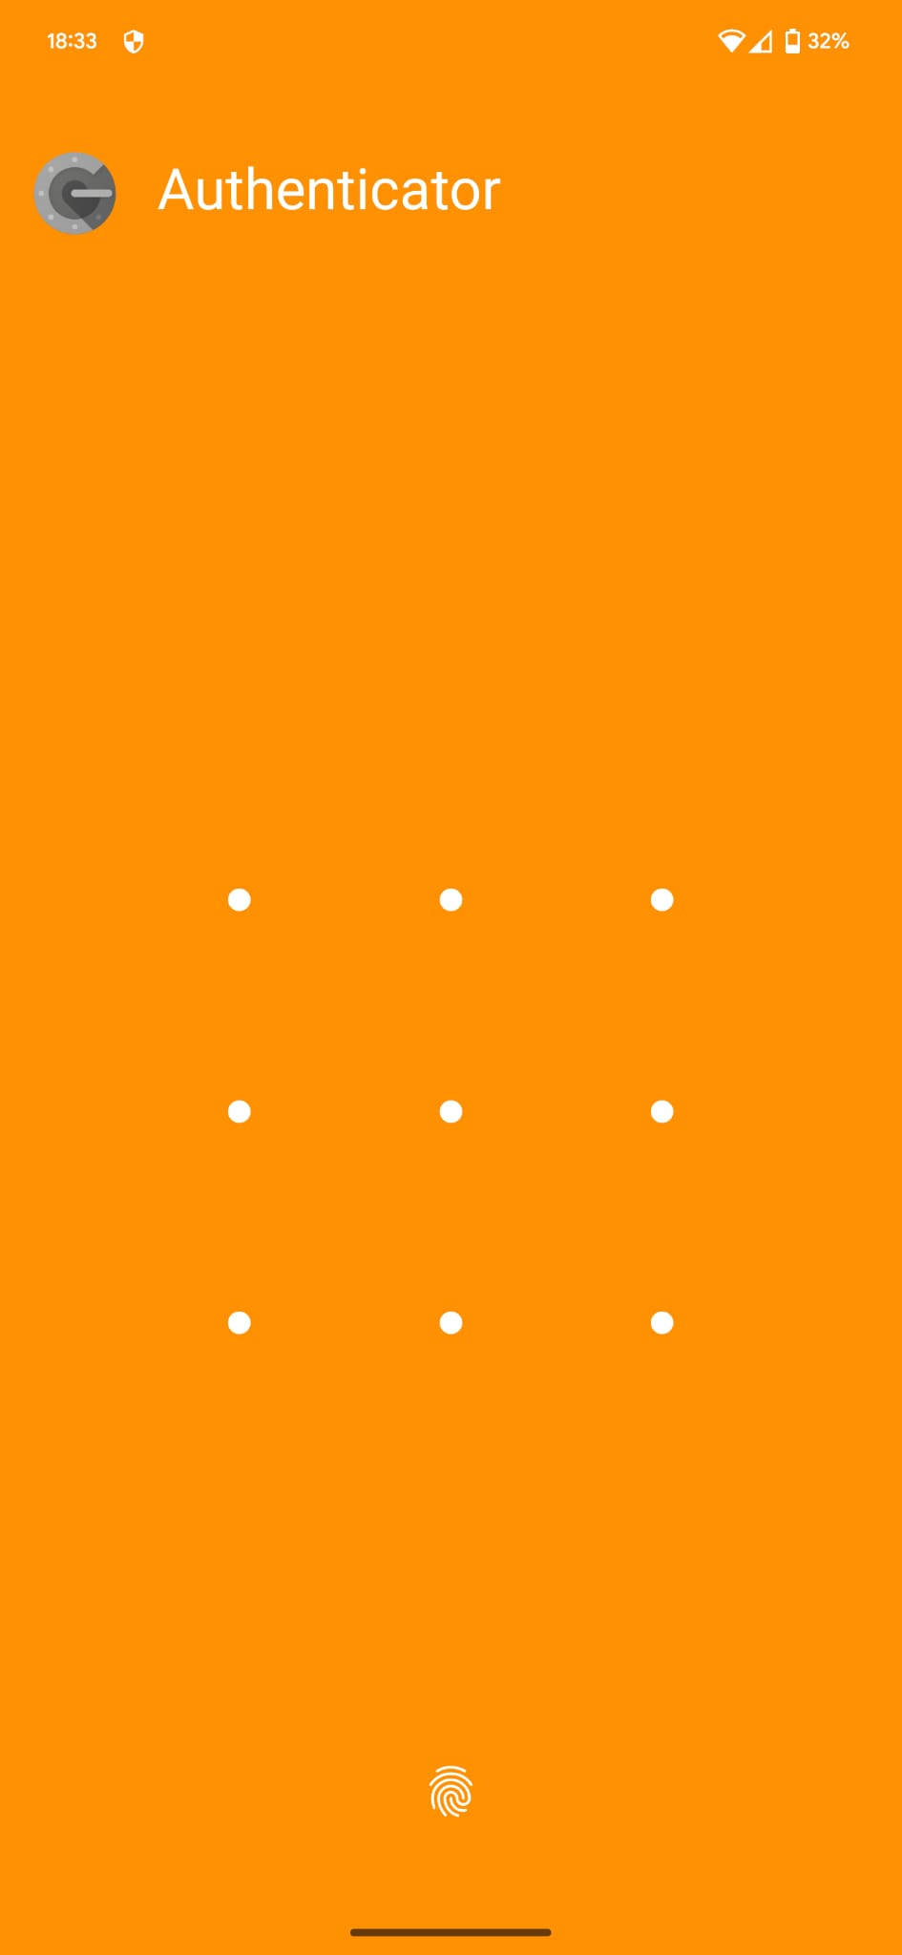
Progress so Far
App Locker
Used open-source implementation (MaxLock)
Ready to be added to overall app but not yet implemented
File Locker
Have begun researching an implementation of this
Will focus more on this in Term 2

Slide 8
Next Steps
Development of Existing Work
Development of New Modules
Focus heavily on the UI of each module
Focus heavily on the main menu UI
Implement the app locker
Combine all background services to improve efficiency
Create an implementation of a file locker
Implement this into overall security suite
Create scripted tests using Junit and Roboelectric

Slide 9
Thank you for Listening
Any Questions?

